Slide 1
Lecture 23
Filters
Hung-yi Lee

Slide 2
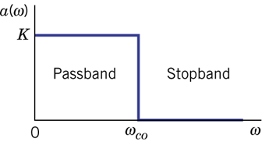
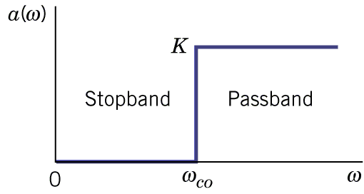
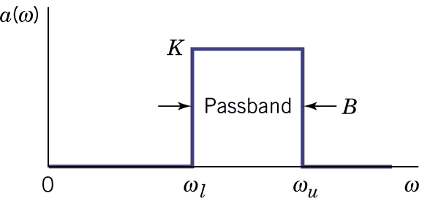
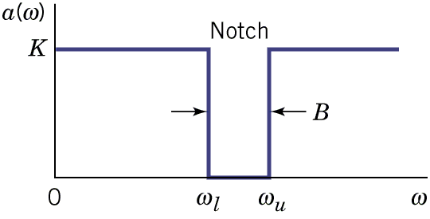
Filter Types
  ω_{co} : cutoff frequency
  Bandwidth Β = ω_{u} - ω_{l}
Lowpass filter
Highpass filter
Bandpass filter
Notch filter

Slide 3
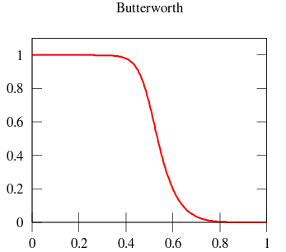
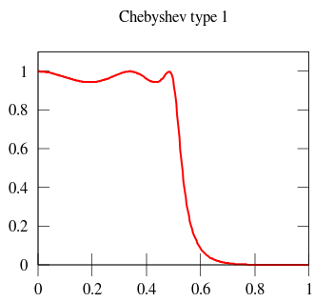
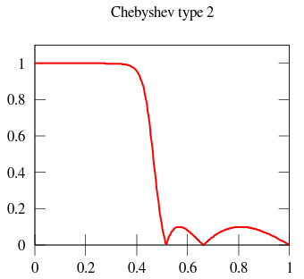
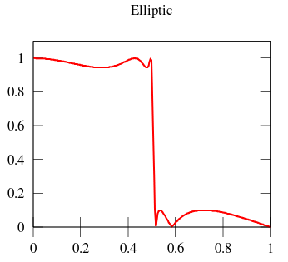
Real World
Ideal filter

Slide 4
Transfer Function – Rules
Filter is characterized by its transfer function
The poles should be at the left half of the s-plane.
We only consider stable filter.
Given a complex pole or zero, its complex conjugate is also pole or zero.

Slide 5
Transfer Function – Rules
Filter is characterized by its transfer function
:improper filter
As the frequency increase, the output will become infinity.
:proper filter
We only consider proper filer.
The filters consider have more poles than zeros.
Notes:
Remember the two rules

Slide 6
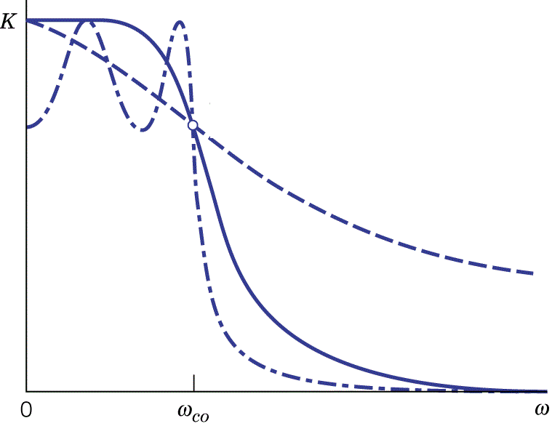
Filter Order
Order = n
The order of the denominator is the order of the filter.
order=1
order=4
order=4

Slide 7
Outline
Textbook: Chapter 11.2
Second-order Filter
First-order Filters
Lowpass
Filter
Highpass
Filter
Lowpass
Filter
Highpass
Filter
Bandpss
Filter
Notch
Filter

Slide 8
First-order Filters

Slide 9
Firsr-order Filters
zero or first order
0 or 1 zero
first order
1 pole
Case 1:
1 pole, 0 zero
Case 2:
1 pole, 1 zero

Slide 10
Firsr-order Filters - Case 1
Lowpass filter
As ω increases
Magnitude decrease
Phase decrease
Pole p is on the negative real axis

Slide 11
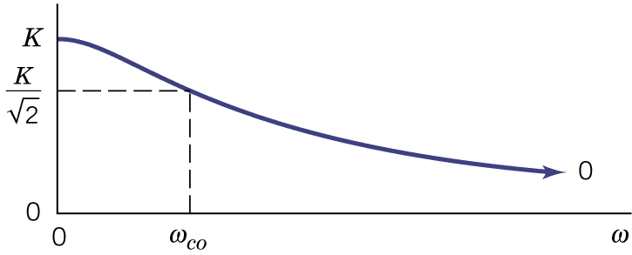
Firsr-order Filters - Case 1
Amplitude of the transfer function of the first-order low pass filter
Ideal Lowpass filter
First-order Lowpass filter

Slide 12
Firsr-order Filters - Case 1
Find cut-off frequency ω_{co} of the first-order low pass filter
Lowpass filter
At DC
Find cut-off frequency ω_{co} such that

Slide 13
Firsr-order Filters - Case 2
Case 2-1: Absolute value of zero is smaller than pole
Magnitude is proportional to the length of green line divided by the length of the blue line
Zero can be positive or negative
Low frequency ≈ |z|/|p|
Because |z|<|p|
The low frequency signal will be attenuated
If z=0, the low frequency can be completely block
Not a low pass

Slide 14
Firsr-order Filters - Case 2
Case 2-1: Absolute value of zero is smaller than pole
Magnitude is proportional to the length of green line divided by the length of the blue line
High frequency
The high frequency signal will pass
If z=0 (completely block low frequency)
High pass

Slide 15
First-order Filters - Case 2
Find cut-off frequency ω_{co} of the first-order high pass filter
(the same as low pass filter)

Slide 16
First-order Filters - Case 2
Case 2-2: Absolute value of zero is larger than pole
Low frequency ≈ |z|/|p|
Because |z|>|p|
The low frequency signal will be enhanced.
High frequency: magnitude is 1
The high frequency signal will pass.
Neither high pass nor low pass
Notes:
http://web.mit.edu/6.302/www/pz/

Slide 17
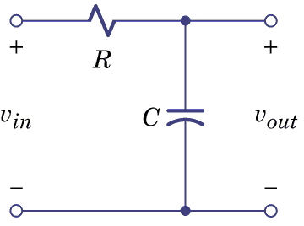
First-order Filters
Consider v_{in} as input
(pole)
If v_{l} is output
Lowpass filter
If v_{h} is output
Highpass filter
(pole)
Notes:
Reasonable from intuition

Slide 18
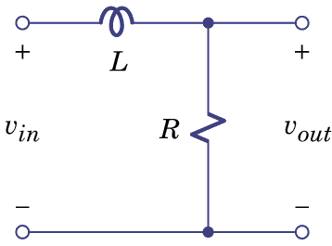
First-order Filters
(pole)

Slide 19
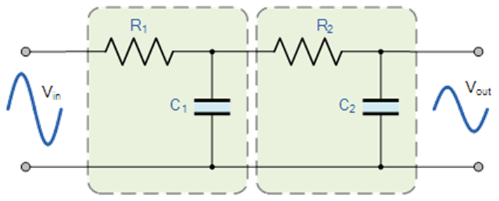
Cascading Two Lowpass Filters

Slide 20
Cascading Two Lowpass Filters

Slide 21
Cascading Two Lowpass Filters
The first low pass filter is influenced by the second low pass filter!

Slide 22
Cascading Two Lowpass Filters

Slide 23
Cascading Two Lowpass Filters

Slide 24
Second-order Filters

Slide 25
Second-order Filter
0, 1 or 2 zeros
Second order
2 poles
Case 1:
No zeros
Must having two poles
Case 2:
One zeros
Case 3:
Two zeros

Slide 26
Second-order Filter – Case 1
Case 1-1
Case 1-2

Slide 27
Second-order Filter – Case 1
Case 1-1
Real Poles
The magnitude is
As ω increases
The magnitude monotonically decreases.
Decrease faster than first order low pass

Slide 28
Second-order Filter – Case 1
Case 1-2
Complex Poles
The magnitude is
As ω increases,
l₁ decrease first and then increase.
l₂ always increase
What will happen to magnitude?
1. Increase
2. Decrease
3. Increase, then decrease
4. Decrease, then increase

Slide 29
Second-order Filter – Case 1
Case 1-2
Complex Poles
If ω > ω_{d}
l₁ and l₂ both increase.
The magnitude must decrease.
What will happen to magnitude?
1. Increase
2. Decrease
3. Increase, then decrease
4. Decrease, then increase

Slide 30
Second-order Filter – Case 1
Case 1-2
Complex Poles
When ω < ω_{d}
Maximize the magnitude
Minimize

Slide 31
Second-order Filter – Case 1
Minimize
Minimize
(maximize)

Slide 32
Second-order Filter – Case 1
Lead to maximum
The maxima exists when
Peaking
No Peaking
Peaking

Slide 33
Second-order Filter – Case 1
Lead to maximum
The maxima exists when
Peaking
Assume

Slide 34
Second-order Filter – Case 1
For complex poles

Slide 35
Second-order Filter – Case 1
Q times
Q times of DC gain
Notes:
Not the peak value

Slide 36
Second-order Filter – Case 1
Lead to maximum
For complex poles

Slide 37
Second-order Filter – Case 1
Lead to maximum
Lead to maximum
The maximum value is
The maximum exist when
Notes:
Bad number ……

Slide 38
Second-order Filter – Case 1
Case 1-1
Real Poles
Case 1-2
Complex Poles
(No Peaking)
Which one is considered as closer to ideal low pass filter?

Slide 39
Complex poles
Peaking
(Butterworth filter)

Slide 40
Butterworth – Cut-off Frequency
ω₀ is the cut-off frequency for the second-order lowpass butterworth filter
(Go to the next lecture first)

Slide 41
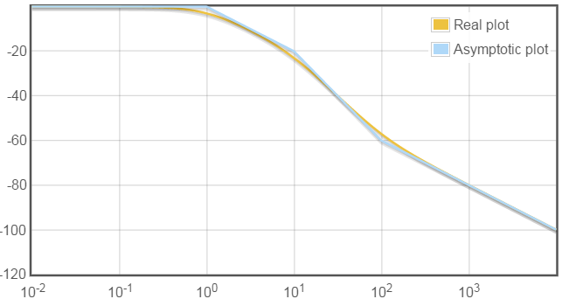
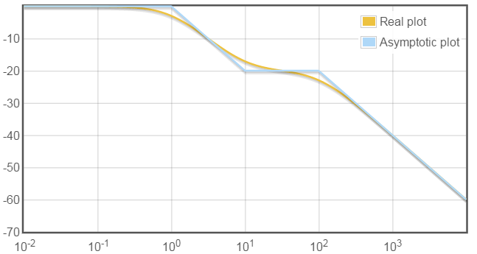
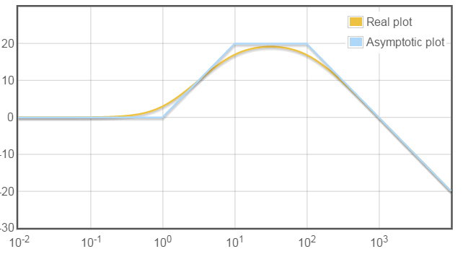
Second-order Filter – Case 2
Case 2: 2 poles and 1 zero
Case 2-1: 2 real poles and 1 zero

Slide 42
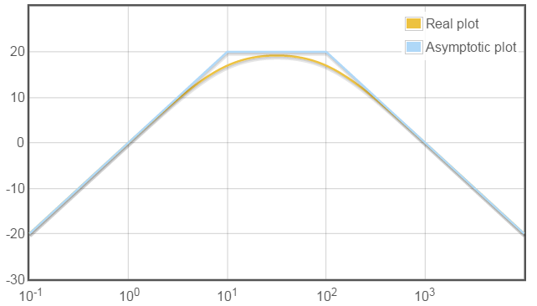
Second-order Filter – Case 2
Case 2: 2 poles and 1 zero
Case 2-1: 2 real poles and 1 zero
flat
Bandpass Filter
Notes:
Plat 辮子

Slide 43
Second-order Filter – Case 2
Case 2-2: 2 complex poles and 1 zero
Two Complex Poles
-40dB
+
Zero
+20dB

Slide 44
Second-order Filter – Case 2
Case 2-2: 2 complex poles and 1 zero
Two Complex Poles
-40dB
-40dB
-20dB
+
+20dB
-20dB
Zero
+20dB

Slide 45
Second-order Filter – Case 2
Case 2-2: 2 complex poles and 1 zero
Highly Selective
Two Complex Poles
-40dB
+20dB
-20dB
+
Zero
+20dB
Bandpass Filter

Slide 46
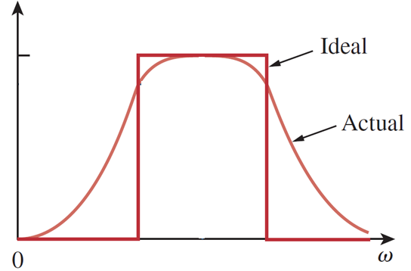
Bandpass Filter
Bandpass filter: 2 poles and zero at original point
Find the frequency for the maximum amplitude
bandpass filter
ω₀?

Slide 47
Bandpass Filter
Find the frequency for the maximum amplitude

Slide 48
Bandpass Filter
Find the frequency for the maximum amplitude
is maximized
when
(Center frequency)
The maximum value is K’.
(Bandpass filter)

Slide 49
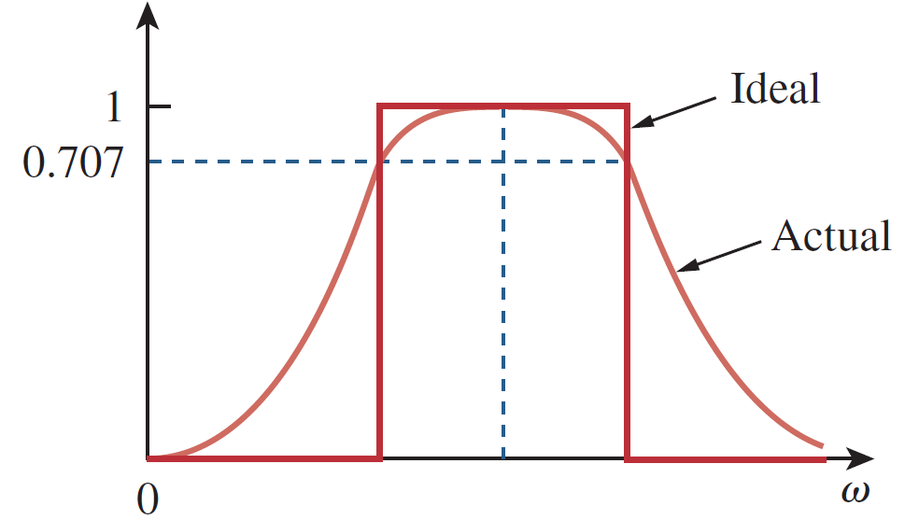
Bandpass Filter
is maximized
when
The maximum value is K’.
bandpass filter
B
Bandwidth B
= ω_{r} - ω_{l}

Slide 50
Bandpass Filter - Bandwidth B
Four answers?
Pick the two positive ones as ω_{l} or ω_{r}

Slide 51
Bandpass Filter - Bandwidth B
Q measure the narrowness of the pass band
Q is called quality factor

Slide 52
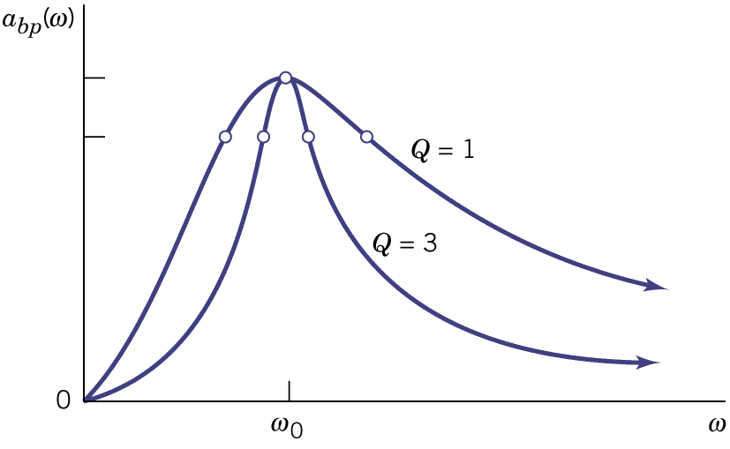
Bandpass Filter
Usually require a specific bandwidth
The value of Q determines the bandwidth.
When Q is small, the transition would not be sharp.

Slide 53
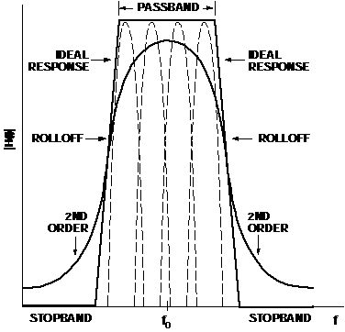
Stagger-tuned Bandpass Filter

Slide 54
Stagger-tuned Bandpass Filter
- Exercise 11.64
Bandpass Filter
Center frequency: 10Hz
Bandpass Filter
Center frequency: 40Hz
We want flat passband.
Tune the value of Q to achieve that

Slide 55
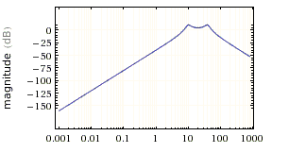
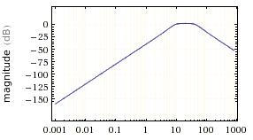
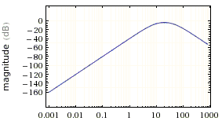
Stagger-tuned Bandpass Filter
- Exercise 11.64
Test Different Q
Q=3
Q=1
Q=0.5

Slide 56
Second-order Filter – Case 3
Case 3: Two poles, Two zeros
  Case 3-1: Two real zeros
  Two real poles
  Two Complex poles
High-pass

Slide 57
Second-order Filter – Case 3
Case 3: Two poles, Two zeros
  Case 3-2: Two Complex zeros
Fix ω₀
Larger Q
Larger θ
Fix ω_{β}
Larger Q _{β}
Larger θ _{β}
Notes:
Describe sth.

Slide 58
Second-order Filter – Case 3
Case 3: Two poles, Two zeros
  Case 3-2: Two Complex zeros
Two poles
-40dB
Two zeros
+40dB
Notes:
Describe sth.

Slide 59
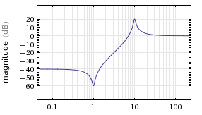
Second-order Filter – Case 3
Case 3: Two poles, Two zeros
  Case 3-2: Two Complex zeros
High-pass
Notch

Slide 60
Second-order Filter – Case 3
Case 3: Two poles, Two zeros
  Case 3-2: Two Complex zeros
Two poles
-40dB
Two zeros
+40dB
Notes:
Describe sth.

Slide 61
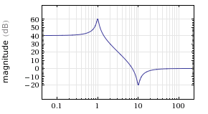
Second-order Filter – Case 3
Case 3: Two poles, Two zeros
  Case 3-2: Two Complex zeros
Low-pass
Notch
Notes:
Describe sth.

Slide 62
Second-order Filter – Case 3
Case 3: Two poles, Two zeros
  Case 3-2: Two Complex zeros
Large Q
Two poles
-40dB
Two zeros
+40dB
small Q_{β}
Notes:
Describe sth.

Slide 63
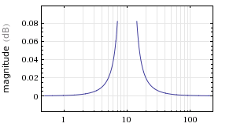
Second-order Filter – Case 3
Case 3: Two poles, Two zeros
  Case 3-2: Two Complex zeros
Notes:
Describe sth.

Slide 64
Second-order Filter – Case 3
Case 3: Two poles, Two zeros
  Case 3-2: Two Complex zeros
small Q
Two poles
-40dB
Two zeros
+40dB
Larger Q_{β}
Notes:
Describe sth.

Slide 65
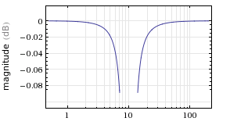
Second-order Filter – Case 3
Case 3: Two poles, Two zeros
  Case 3-2: Two Complex zeros
Standard
Notch
Filter
Notes:
Describe sth.

Slide 66

Second-order Filter – Case 3
Case 3: Two poles, Two zeros
  Case 3-2: Two Complex zeros
If the two zeros are on the ω axis
The notch filter will completely block the frequency ω₀
Notes:
Describe sth.

Slide 67
Notch Filter
The extreme value is at ω= ω₀
(Notch filter)

Slide 68
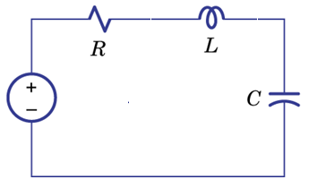
Second-order RLC Filters
A
B
C
D
RLC series circuit can implement high-pass, low-pass, band-pass and notch filter.

Slide 69
Second-order RLC Filters
A
B
DC (O)
Infinity (X)
DC (X)
Infinity (O)
Low-pass Filter
High-pass Filter

Slide 70
Second-order RLC Filters
C
Band-pass Filter

Slide 71
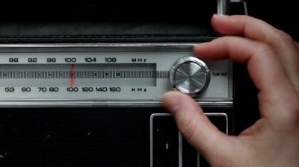
Second-order RLC Filters
– Band-pass
C
40pF to 360pF
L=240μH, R=12Ω
Frequency range
Center frequency:
Max: 1.6MHz
min: 0.54MHz

Slide 72
Second-order RLC Filters
– Band-pass
C
40pF to 360pF
L=240μH, R=12Ω
Frequency range
0.54MHz ~ 1.6MHz
Q is 68 to 204.

Slide 73
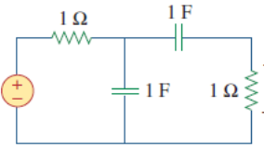
Band-pass

Slide 74
Band-pass
Band-pass Filter

Slide 75
Second-order RLC Filters
C
D
Notch Filter

Slide 76
Active Filter

Slide 77
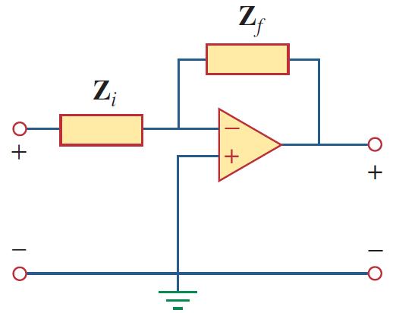
Basic Active Filter
-i
i
0
0

Slide 78
First-order Low-pass Filter

Slide 79
First-order High-pass Filter

Slide 80
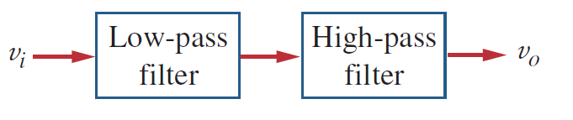
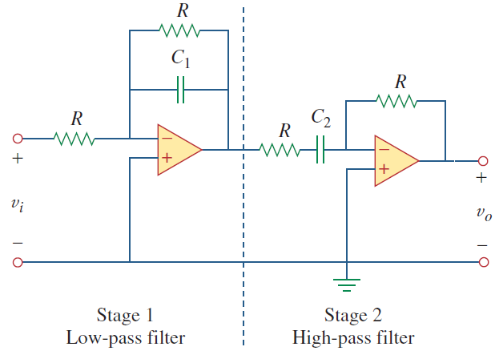
Active Band-pass Filter
Band-pass Filter
Notes:
Union of low and high

Slide 81
Active Band-pass Filter
?

Slide 82
Loading
The loading Z will change the transfer function of passive filters.
The loading Z will NOT change the transfer function of the active filter.

Slide 83
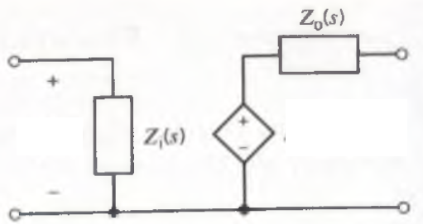
Cascading Filters
If there is no loading
The transfer function is H(s).
One Filter Stage Model

Slide 84
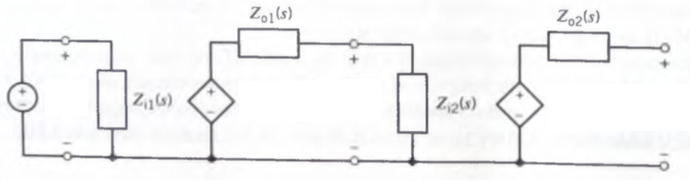
Cascading Filters
1st Filter with
transfer function H₁(s)
2st Filter with
transfer function H₂(s)
Overall Transfer Function:

Slide 85
Cascading Filters
1st Filter with
transfer function H₁(s)
2st Filter with
transfer function H₁(s)

Slide 86
Cascading Filters
1st Filter with
transfer function H₁(s)
2st Filter with
transfer function H₁(s)
If zero output impedance (Z_{o1}=0)
or If infinite input impedance (Z_{i2}=∞)

Slide 87
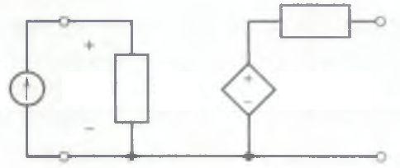
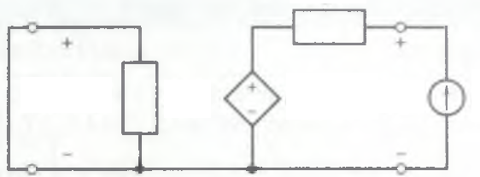
Cascading Filters
– Input & Output Impedance

Slide 88

Cascading Filters
– Basic Active Filter
If zero output impedance (Z_{o1}=0)
or If infinite input impedance (Z_{i2}=∞)
=0
-i
=0
i
0
0
0
=0

Slide 89
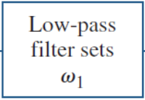
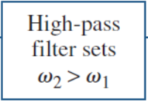
Active Notch Filter
A
B
Which one is correct?

Slide 90
Active Notch Filter
Low-pass Filter
Add
Together
High-pass Filter
Notes:
cover

Slide 91
Homework
  11.19

Slide 92
Thank you!

Slide 93
Answer
  11.19: Ra=7.96kΩ, Rb= 796Ω,
      va(t)=8.57cos(0.6ω₁t-31。)
  +0.83cos(1.2ω₂t-85。)
  vb(t)=0.60cos(0.6ω₁t+87。)
  +7.86cos(1.2ω₂t+40。)
  (ω₁ and ω₂ are 2πf₁ and 2πf₂ respectively)
  11.22: x=0.14, ωco=0.374/RC
  11.26(refer to P494): ω0=2π X 6 X 10^4, B= ω0=2π X 5 X 10^4, Q=1.2, R=45.2Ω, C=70.4nF
  11.28(refer to P494): C=0.25μF, Qpar=100, Rpar=4kΩ, R||Rpar=2kΩ, R=4kΩ

Slide 94
Acknowledgement
  感謝 江貫榮(b02)
  上課時指出投影片的錯誤
  感謝 徐瑞陽(b02)
  上課時糾正老師板書的錯誤

Slide 95
Appendix

Slide 96

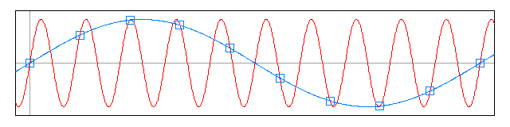
Aliasing
Wrong Interpolation
Actual signal
Sampling
High frequency becomes low frequency

Slide 97
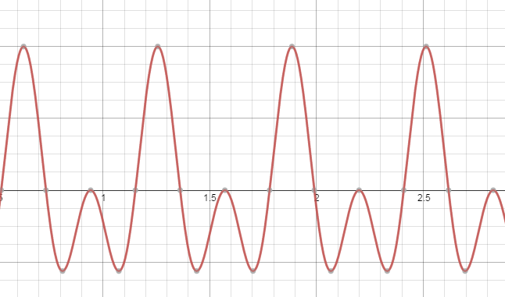
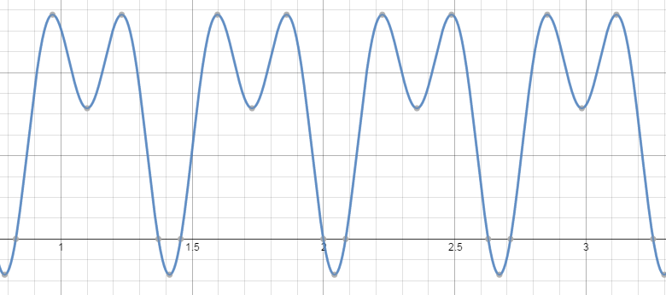
Phase
filter

Slide 98
  Table 11.3 Simple Filter
  Type Transfer Function Properties
  Lowpass
  Highpass
  Bandpass
  Notch
98

Slide 99
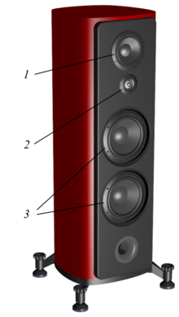
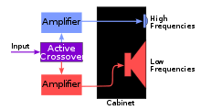
Loudspeaker for home usage with three types of dynamic drivers
1. Mid-range driver
2. Tweeter
3. Woofers

Slide 100
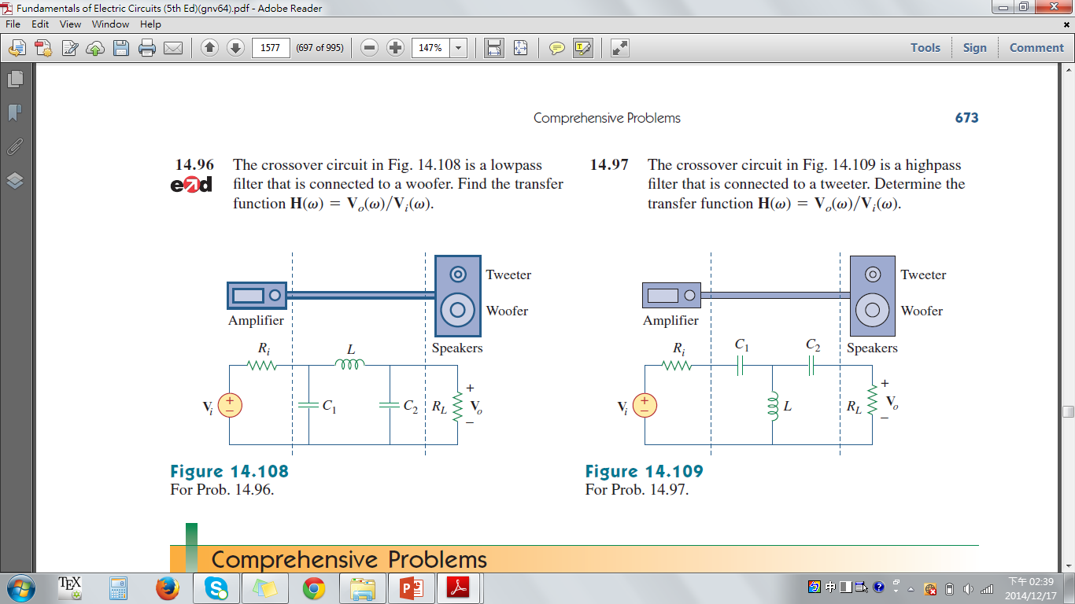
https://www.youtube.com/watch?v=3I62Xfhts9k

Slide 102
From Wiki
Butterworth filter – maximally flat in passband and stopband for the given order
Chebyshev filter (Type I) – maximally flat in stopband, sharper cutoff than Butterworth of same order
Chebyshev filter (Type II) – maximally flat in passband, sharper cutoff than Butterworth of same order
Bessel filter – best pulse response for a given order because it has no group delay ripple
Elliptic filter – sharpest cutoff (narrowest transition between pass band and stop band) for the given order
Gaussian filter – minimum group delay; gives no overshoot to a step function.

Slide 103
Link
http://www.ti.com/lsds/ti/analog/webench/webench-filters.page
http://www.analog.com/designtools/en/filterwizard/#/type

Slide 104
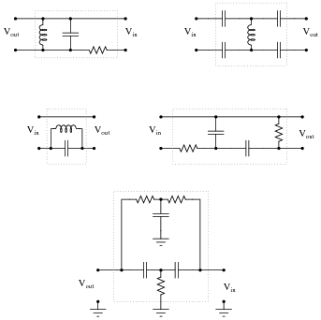
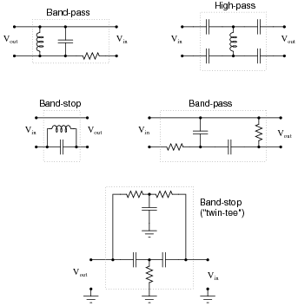

Slide 105
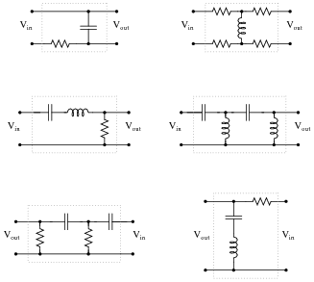
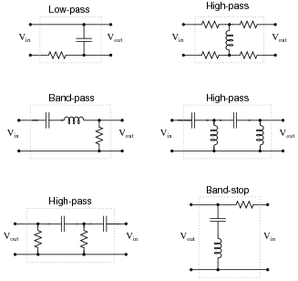

Slide 106

Suppose this band-stop filter were to suddenly start acting as a high-pass filter. Identify a single component failure that could cause this problem to occur:
If resistor R₃ failed open, it would cause this problem. However, this is not the only failure that could cause the same type of problem!

